Slide 1
Get your concepts Straight

Slide 2
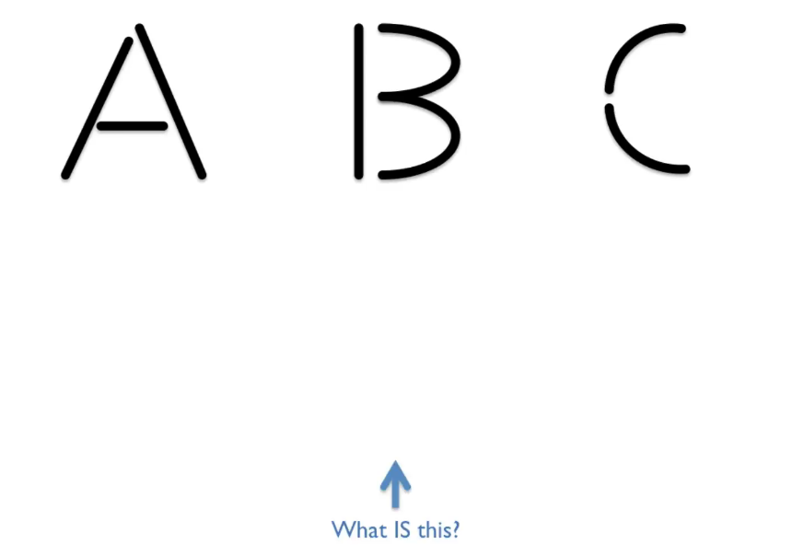
So take a very concrete example about how concepts operate in our minds.

Slide 3
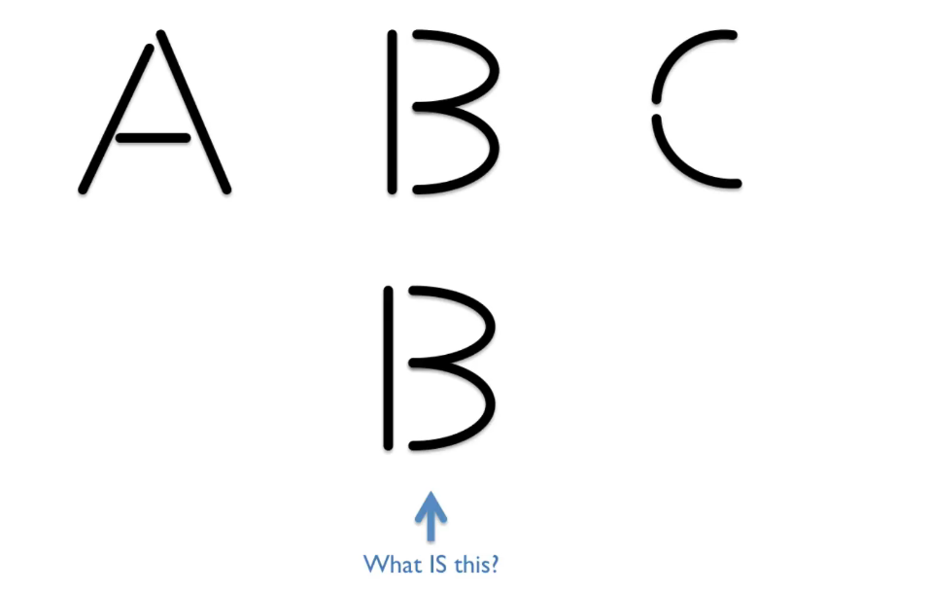
Most people will say it is B

Slide 4
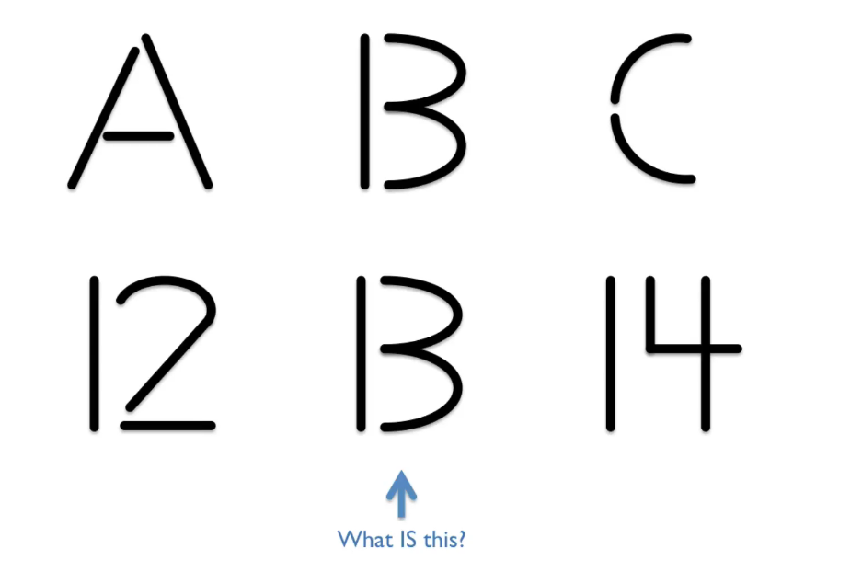
Is is still B

Slide 5
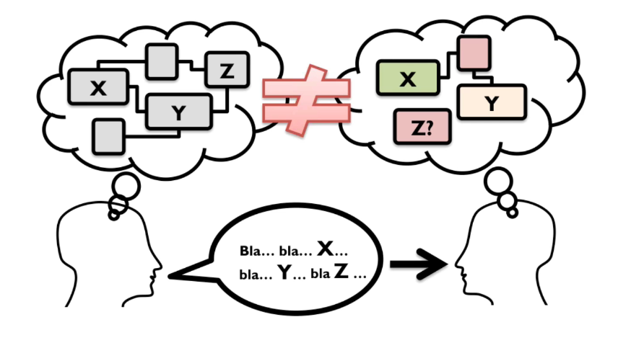

Slide 6
I Think That You Think That I Think That You Think…

Slide 7
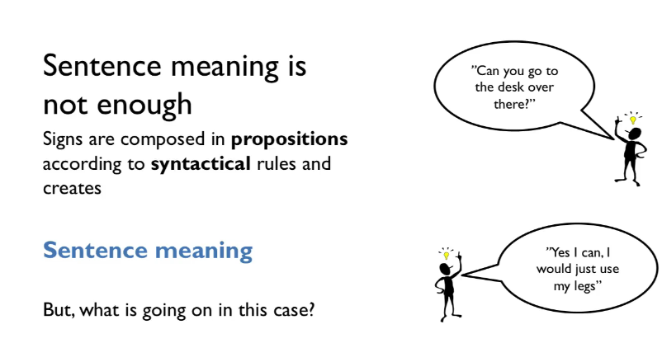
Sentence Meaning is not enough. It is the intended meaning

Slide 8
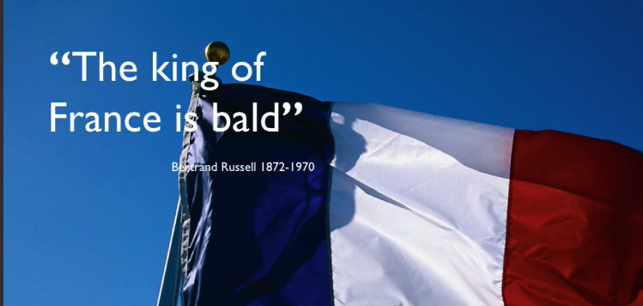
"The King of France is Bald" Is False,But So Is "The King Of France is Not Bald

Slide 9
the sentence 'the present king of France is bald' is false because the present king of France doesn't exist

Slide 10
will propel your success rate in delivering value and getting rid of the most crucial waste; the waste of doing the wrong things, in the wrong order for the wrong reason.

Slide 11
we should straighten out our concepts is a little bit blurry thing to say. So I'm will try to exemplify and make that a little bit more clearer. But let's say that we didn't even have the same understanding of the things. So imagine if imagine if no one actually used the same terms for any of the things that were managed. I don't know if you recognize this, but I see this a lot. My question then is how long would it take until we start doing disastrous mistakes? I don't know about you, but I think I see this on an everyday basis in most businesses and common situations that I'm part of, and it's a big problem and it's all about concepts. They are building blocks. So concepts three theoretically, are the constituents of thoughts. So what is collective intentionality? So in coordination with others, we create the possibility of collective intentionality, and it's emerges

